Slide 1
Welcome to Week-12
Advanced Programming in Python
By Engr. Imran Khan
Instructor
5th September 2021

Slide 2
Today
Model Evaluation and Selection
Classifier Decision Functions
Multi-Class Evaluation
Model Selection
Optimizing Classifier for Different Evaluation Metrices

Slide 3
Model Evaluation
Confusion matrix
Accuracy
Precision
Recall
Specificity
F1 score
Precision-Recall or PR curve
ROC (Receiver Operating Characteristics) curve
PR vs ROC curve.

Slide 4
Model Evaluation
True positives (TP): Predicted positive and are actually positive.
False positives (FP): Predicted positive and are actually negative.
True negatives (TN): Predicted negative and are actually negative.
False negatives (FN): Predicted negative and are actually positive.

Slide 5
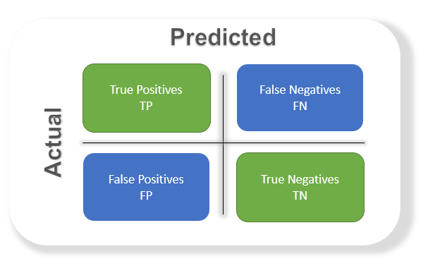
Confusion matrix
It’s just a representation of the above parameters in a matrix format

Slide 6
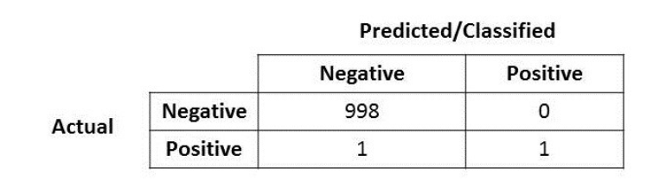

Accuracy
Correctly Predicted Data points
What’s Accuracy of the below results?

Slide 7
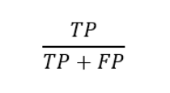
Precision
Percentage of positive instances out of the total predicted positive instances
“how much the model is right when it says it is right”.

Slide 8
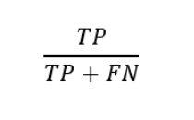
Recall/Sensitivity/True Positive Rate
Percentage of positive instances out of the total actual positive instances
‘how much extra right ones, the model missed when it showed the right ones’.

Slide 9
Specificity
Percentage of negative instances out of the total actual negative instances.
It is similar to recall but the shift is on the negative instances.
Like finding out how many healthy patients were not having cancer and were told they don’t have cancer.

Slide 10
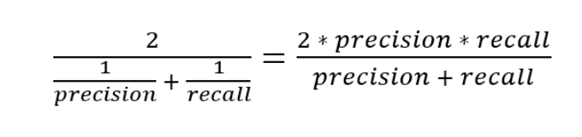
F1 Score
It is the harmonic mean of precision and recall.
This takes the contribution of both, so higher the F1 score, the better.
model does well in F1 score if the positive predicted are actually positives (precision) and doesn't miss out on positives and predicts them negative (recall).

Slide 11
What Is Model Selection?
Model selection is the process of selecting one final machine learning model from among a collection of candidate machine learning models for a training dataset.

Slide 12
I HOPE YOU LEARN A LOT & ENJOY THE TRAINING! THANK YOU ☺

